Slide 1

Software Development Tools & Practices
PUSL2020
Level 2
“Introduction to Web Technologies (Part II)”
Dr. Rasika Ranaweera (ranaweera.r@nsbm.ac.lk | +94 11 544 6126)
Faculty of Faculty of Postgraduate Studies & Professional Advancement | NSBM Green University

Slide 2

Overview
Page Lifecycle
ASP.NET and PHP forms
Remembering state information

Slide 3

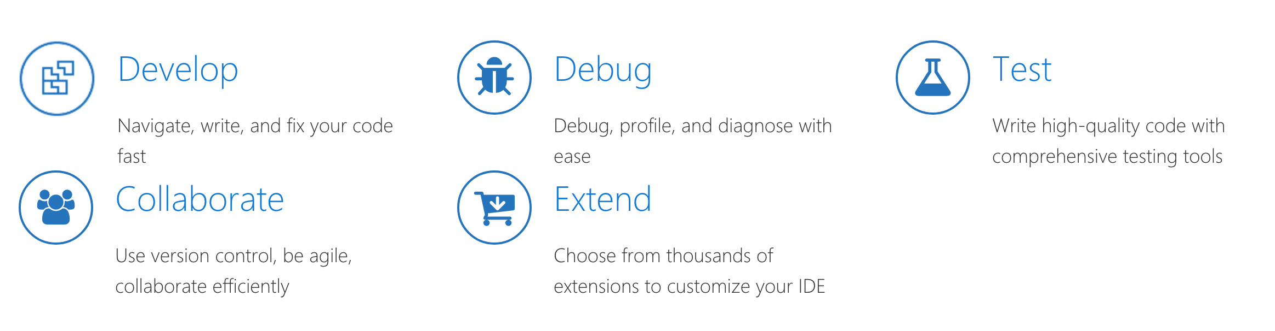
Microsoft Visual Studio
Notes:
https://visualstudio.microsoft.com/vs/getting-started/

Slide 4
ASP.NET (History)
Introduced with the .NET Framework in 2002
  It made Web development look like traditional Windows development
ASP.NET 2.0 introduced in 2005 gave developers enhanced database tools
  Including desktop improvements
  MVC was introduced later
ASP.NET 3.0 released with 2008
ASP.NET 4 released with Visual Studio 2010 and version 4 of the Framework
  Razor was introduced along with ASP.NET Web pages
Current version is Visual Studio 2022 and Framework version 4.8.0
Notes:
https://visualstudio.microsoft.com/vs/getting-started/

Slide 5
ASP.NET Web Forms
Provides server-side tools for site navigation
  Menus, Drill-down toolbars, breadcrumbs, etc.
Authentication tools
Database connections
Client and server executable code
State management and caching
Authentication and role management
Deployment tools
Robust development tools (Visual Studio)

Slide 6
Web Forms and Stateful Web Programming
Remember that the Web is stateless
  Web servers to not persist state from one request to the next
ASP.NET does allow stateful programming though
  various hidden fields and serialized data
  server side session objects
  More on state management later

Slide 7
Creating a Web Form
Every .aspx file corresponds to a Web page
Click Website / Add New Item
  Select Web Form
  Select the master page, if desired
  Set the name as desired

Slide 8
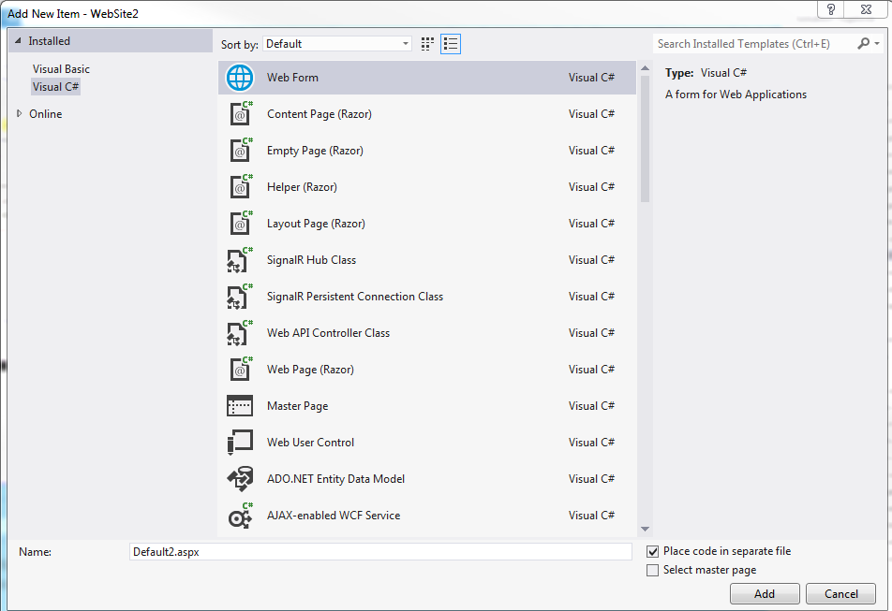
Adding a Web Form

Slide 9
The Web Form Editor
The Web Form editor allows you to
  Create HTML5
  Create ASP.NET server side tags
  Create the “code behind” the form in a language such as Visual Basic or C#
The Web form editor has three views
  Design / Split / Source

Slide 10
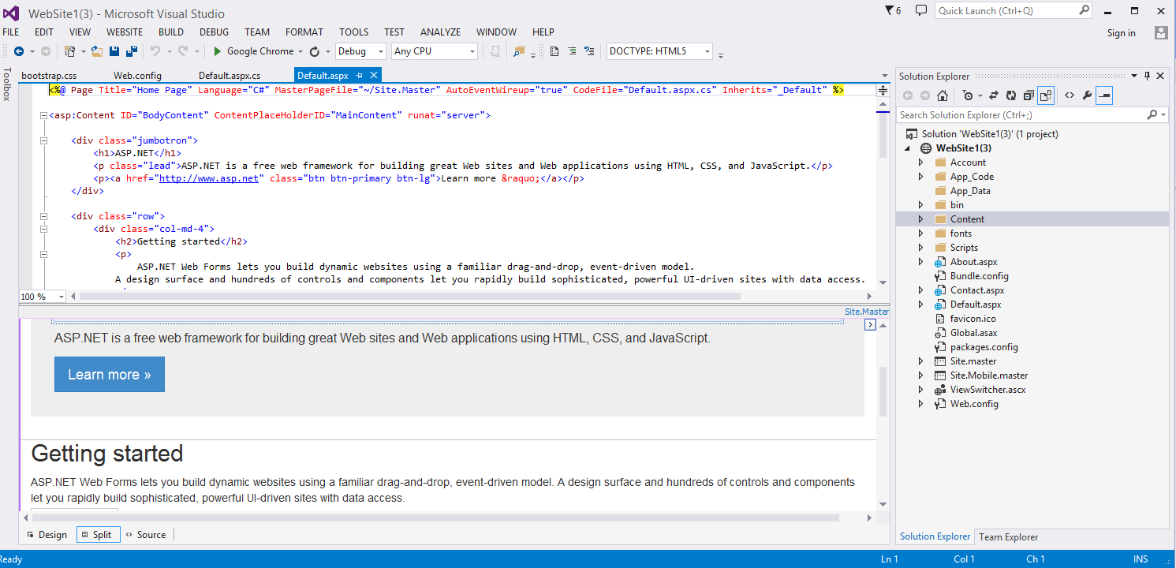
The Web Form Editor

Slide 11
Default Web Page Code (HTML)
A Web Form contains a @Page directive
  Makes the page a Web form
  The remaining HTML should look familiar to you
  Note there is exactly one <form> tag
    ASP.NET controls must appear in the <form>

Slide 12
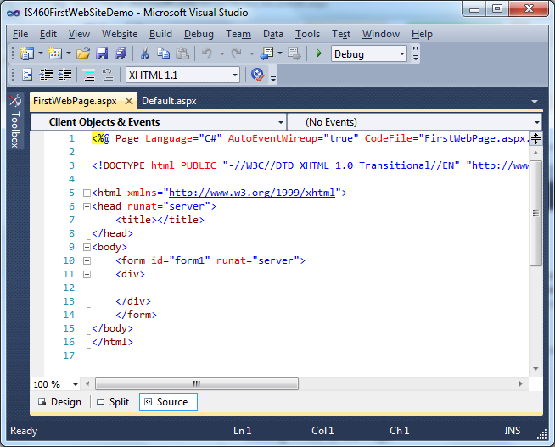
Default Web Page (HTML)

Slide 13
The Code Editor
An ASP.NET Web page is made up of two files
  The .aspx file contains the HTML
  The .aspx.cs file contains the VB or C# code
It works the same way as the Code Editor for desktop applications
  The event names differ a bit
  Page_Load instead of Form_Load for example

Slide 14
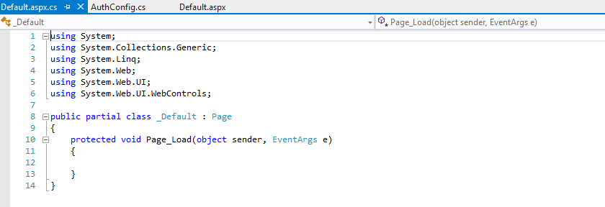
The Code Editor

Slide 15
Toolbox Controls
They are different controls than those used for desktop applications
HTML controls are standard HTML controls that will work with any browser
Other controls are server side controls that only work with IIS and ASP
Using the Toolbox, drag the desired control to the design surface
  You can drag to the design surface or the HTML editor
Set properties using the Properties window
Create event handlers using the Properties window

Slide 16
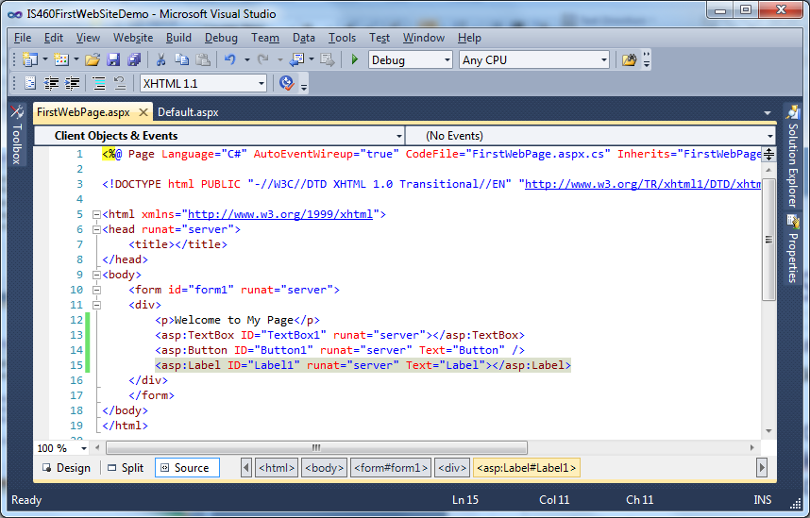
ASP.NET Controls
ASP controls have an <asp:> prefix. These are actually XML namespaces

Slide 17
Creating Event Handlers (2)
There are a couple of ways to do this
The easiest way is to select Design View
  Then double-click the control to create the “default” event handler
Or use the event tab on the Properties window
Or create it by hand

Slide 18
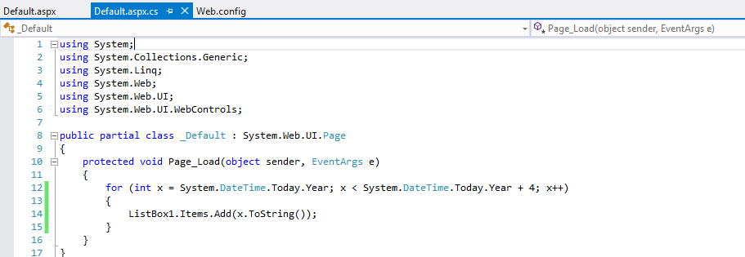
Event Handler Example

Slide 19
Page Inspector
On the server ASP writes HTML5 code
  All of the ASP stuff is stripped away
Use the Page Inspector to see the emitted code
In the Solution Explorer, right click the Web Site and select View in Page Inspector

Slide 20
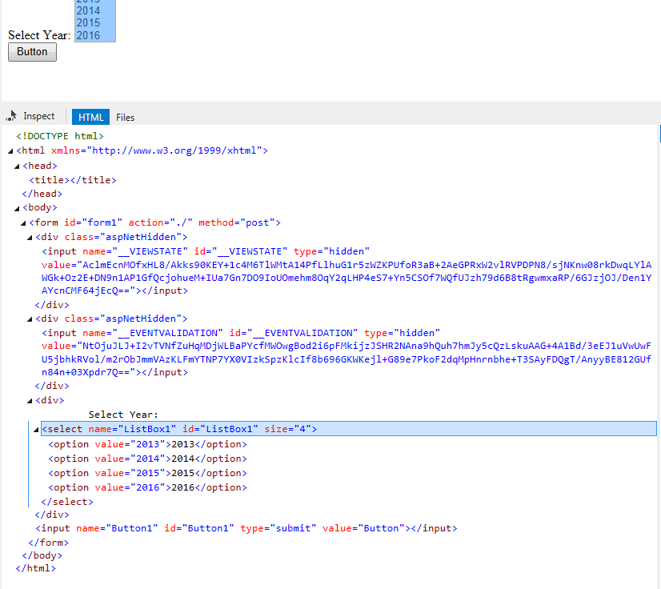
Page
Inspector

Slide 21
Setting the Start Page
Every Web site has exactly one page designated as the start (default) page
To set the start page, right-click the page in the Solution Explorer
  Click Set as Start Page

Slide 22
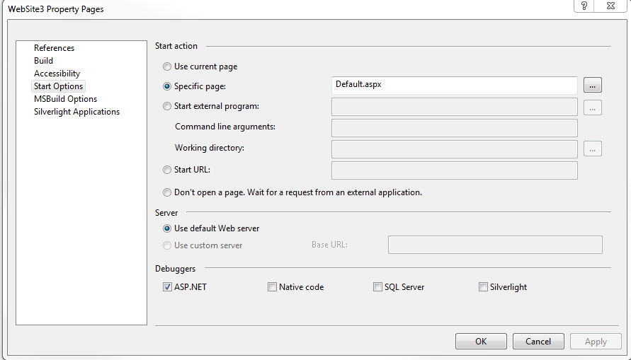
Setting the Start Page

Slide 23
Running the Application
It’s possible to run an ASP.NET application from Visual Studio
  There is a “test” Web server built in
Just press F5 to run the application
  It appears in the default Web browser
You will see a message to enable debugging when the application is run the first time

Slide 24
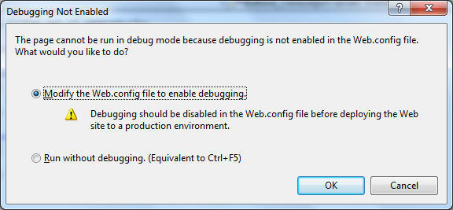
Running the Application

Slide 25
Debugging
Debugging windows work the same way in desktop and ASP.NET applications
  Set breakpoints on executable code lines
  Print values to the Immediate window
  Use Watch windows to interrogate the values of variables

Slide 26
Introduction to Error Handling
Just like desktop applications, exceptions are thrown in various cases
  Divide by 0, IO, Database, etc.
Unhandled, we call these the yellow page of death
What happens depends on the following Web.config setting:
<compilation debug="false">

Slide 27
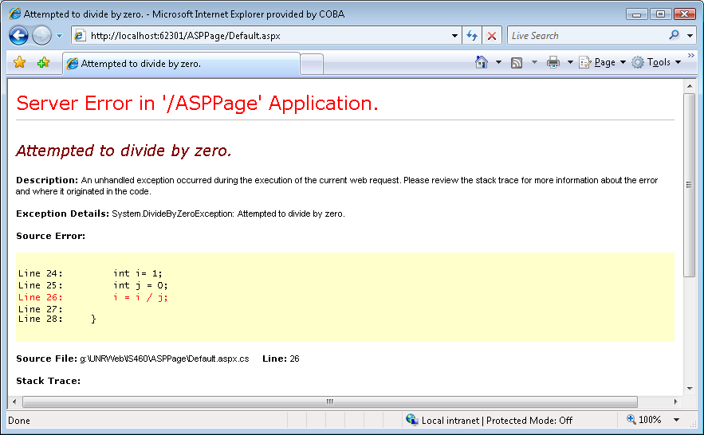
Error Message (Debug=true)

Slide 28
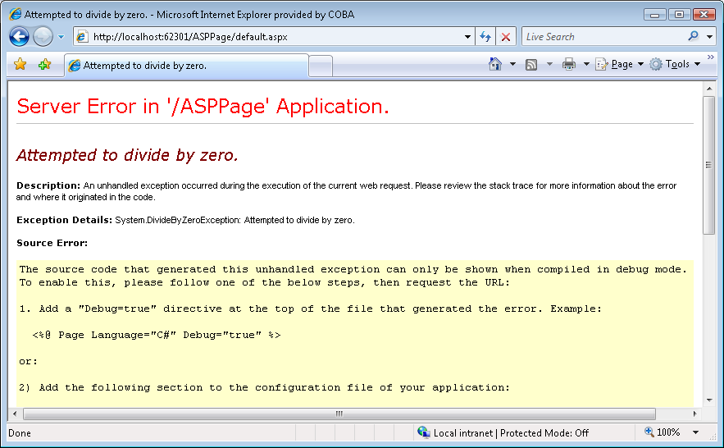
Error Message (Debug=false)

Slide 29
Master and Content Pages
When the pages in a site should share a common theme
  Master pages contain the reusable theme
    The file is typically named site.master
  Content pages appear in the master page

Slide 30
ASP.NET Coding
There are two ways to do it
  Inline (code appears in the same file as the .aspx file)
    Put in a <script> block with runat=“server”
  Separate code behind file

Slide 31
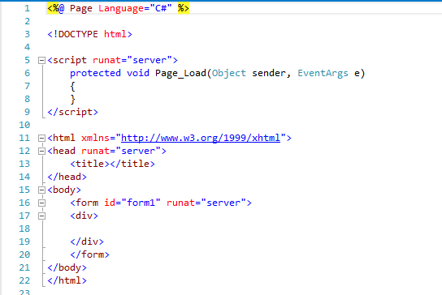
ASP.NET Inline Code

Slide 32
ASP.NET Code Behind
They are matching .aspx and .aspx.cs files that are hopelessly tied together
@Page directives are important
  The CodeBehind attribute points to the .cs file
  The Language attribute identifies the programming language
    VB / C#

Slide 33
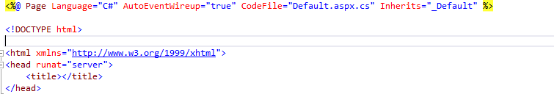
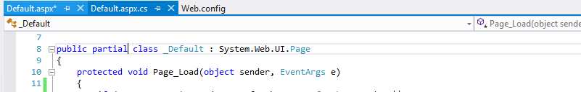
ASP.NET Code Behind

Slide 34
Introduction to Page Events
First, this topic is very important to getting your ASP applications to work
ASP uses the eventing model to
  Persist state from one postback to the next
  Create static and dynamic controls
  Bind control instances to data sources
  And much more

Slide 35
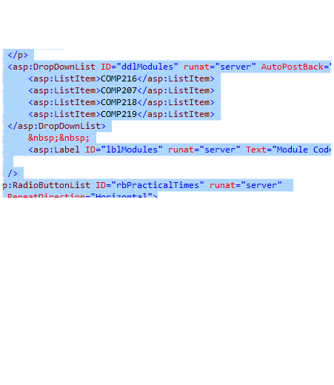
Page Life Cycle
When a page is requested
  The runtime figures out why the page is being processed
    Normal request
    Postback
    Cross-page postback
    callback

Slide 36
Page Life Cycle Stages
Page request: when ASP.Net gets a page request, it decides whether to parse and compile the page or there would be a cached version of the page; accordingly the response is sent
Starting of page life cycle: at this stage, the Request and Response objects are set. If the request is an old request or post back, the IsPostBack property of the page is set to true. The UICulture property of the page is also set.
Page initialization: at this stage, the controls on the page are assigned unique ID by setting the UniqueID property and themes are applied. For a new request postback data is loaded and the control properties are restored to the view-state values.
Page load: at this stage, control properties are set using the view state and control state values.

Slide 37
Page Life Cycle Stages (Cont.)
Validation: Validate method of the validation control is called and if it runs successfully, the IsValid property of the page is set to true.
Postback event handling: if the request is a postback (old request), the related event handler is called.
Page rendering: at this stage, view state for the page and all controls are saved. The page calls the Render method for each control and the output of rendering is written to the OutputStream class of the Page's Response property.
Unload: the rendered page is sent to the client and page properties, such as Response and Request are unloaded and all cleanup done.

Slide 38
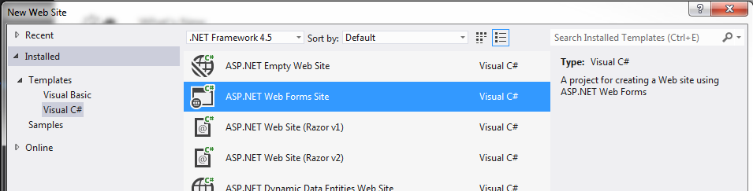
Folder Structure
So far, you have seen a project from an empty template
  Now for a real one

Slide 39
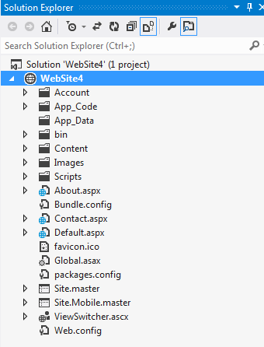
Folder Structure
You get many template files
and folders for free
All this gets compiled
on the server to make
up an ASP.NET app

Slide 40
Folder Structure
App_Code is designed to store shared code files (classes, .wsdl pages)
App_Data is designed to store data files
  Users can read and write data in this folder
The folder Scripts is not magical but we store JavaScript and jQuery here
  Note that the jQuery scripts are copied here by default from the standard template

Slide 41
Global.asax
Global.asax is the global application startup, shutdown, and error file
It contains procedures that are called by the application infrastructure
  Application_Start called when the application gets its first request
  Application_End not used much
  Application_error to handle all unhandled errors

Slide 42

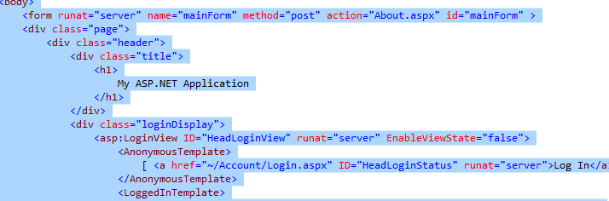
ASP.NET: Post Data
‘action’ attribute gives URL of page receiving the POST request. Does not HAVE to be same URL as page
ASP.NET forms use hidden fields to keep track of previous interactions -
called _VIEWSTATE

Slide 43
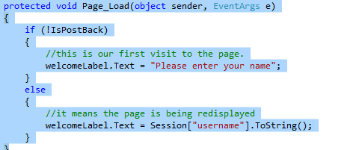
ASP.NET : Event handlers
Similar to Windows Forms projects
Most common event handler = Page_Load
  Usually test the IsPostBack variable to check the state of interaction with the user.
  Remember - if true - user has already interacted with the page and has submitted or posted data.

Slide 44
Cross-Page Posting (Introduction 1)
You can use a HyperLink control to create a link to another page
Any Button control can be used for cross-page postbacks
  Set the PostBackURL property to the desired Web page

Slide 45
Cross-Page Posting (Getting Data from the Previous Page)
The PreviousPage property of the Page object contains a reference to the page that caused the postback
This property allows you to get at the controls from the previous form (page) and their values
  This is magically accomplished through viewstate

Slide 46
Cross-Page Posting (Example)
Get a reference to a control on another page and print the text
TextBox txt;
txt =
(TextBox)PreviousPage.FindControl(
"txtPreserve");
Response.Write(txt.Text);

Slide 47
Detecting Cross-Page Postbasks (1)
Test the PreviousPage property to see if it is null
  If it is, the page was not loaded as a cross-page postback
Test the IsCrossPagePostBack property of the ‘posting’ page

Slide 48
Detecting Cross-Page Postbacks (2)
The @PreviousPageType directive allows you to use strongly typed syntax if page “b” will only be posted from page “a”
  Be careful
<%@ PreviousPageType virtualPath=“a.aspx” %>

Slide 49

Form posting: ASP.net vs PHP
Write a script to design following form. Then write necessary codes/scripts to display user entered values in new web page.

Slide 50
Form posting: ASP.net vs PHP (Cont.)
PHP
<!DOCTYPE HTML>
<html>
<body>
<form action="welcome_get.php" method="get">
Name: <input type="text" name="name"><br>
E-mail: <input type="text" name="email"><br>
<input type="submit">
</form>
</body>
</html>
<html>
<body>
Welcome <?php echo $_GET["name"]; ?><br>
Your email address is: <?php echo $_GET["email"]; ?>
</body>
</html>

Slide 51
Introduction to State Management
Remember that ASP.NET (and the Web) is stateless
  The Web server does not keep track of past client requests
Different technologies handle the issue of statement management differently
  ASP.NET is somewhat unique in this regard

Slide 52
Types of State Management
ASP.NET offers two categories of state management
  Pure client-side statement management
  Server-side state management

Slide 53
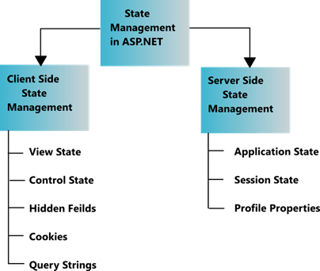
State Management Techniques

Slide 54
Hidden field
Hidden field is a control provided by ASP.NET which is used to store small amounts of data on the client.
It store one value for the variable and it is a preferable way when a variable's value is changed frequently.
Hidden field control is not rendered to the client (browser) and it is invisible on the browser.
A hidden field travels with every request like a standard control’s value.
<asp:HiddenField ID="HiddenField1" runat="server" />

Slide 55
View state
Sometimes the user needs to preserve data temporarily after a post back, then the view state is the preferred way for doing it.
It stores data in the generated HTML using hidden field not on the server.
View State provides page level state management i.e., as long as the user is on the current page, state is available and the user redirects to the next page and the current page state is lost.
View State can store any type of data because it is object type but it is preferable not to store a complex type of data due to the need for serialization and deserilization on each post back.
View state is enabled by default for all server side controls of ASP.NET with a property EnableviewState set to true.
ViewState["count"]=ViewstateVal.ToString();

Slide 56
Cookies
Cookie is a small text file which is created by the client's browser and also stored on the client hard disk by the browser.
It does not use server memory.
Generally a cookie is used to identify users.
Whenever a user makes a request for a page the first time, the server creates a cookie and sends it to the client along with the requested page and the client browser receives that cookie and stores it on the client machine either permanently or temporarily (persistent or non persistence).
The next time the user makes a request for the same site, either the same or another page, the browser checks the existence of the cookie for that site in the folder. If the cookie exists it sends a request with the same cookie, else that request is treated as a new request.

Slide 57
Cookies (Cont.)
Persistence Cookie: Cookies which you can set an expiry date time are called persistence cookies. Persistence cookies are permanently stored till the time you set.
Non-Persistence Cookie: Non persistence cookies are not permanently stored on the user client hard disk folder. It maintains user information as long as the user accesses the same browser. When user closes the browser the cookie will be discarded. Non Persistence cookies are useful for public computers.

Slide 58
Setting cookies
ASP.NET
Response.Cookies["userName"].Value = "patrick";
Response.Cookies["userName"].Expires = DateTime.Now.AddDays(1);
//or
HttpCookie aCookie = new HttpCookie("lastVisit");
aCookie.Value = DateTime.Now.ToString();
aCookie.Expires = DateTime.Now.AddDays(1);
Response.Cookies.Add(aCookie);
if(Request.Cookies["userName"] != null)
Label1.Text = Server.HtmlEncode(Request.Cookies["userName"].Value);
if(Request.Cookies["userName"] != null)
{
HttpCookie aCookie = Request.Cookies["userName"];
Label1.Text = Server.HtmlEncode(aCookie.Value);
}
Set Cookies
Read Cookies

Slide 59
Setting cookies (Cont.)
PHP
Read Cookies
Set Cookies
<html>
<body>
<?php
$cookie_name = "user";
if(!isset($_COOKIE[$cookie_name])) {
echo "Cookie named '" . $cookie_name . "' does not exist!";
} else {
echo "Cookie is named: " . $cookie_name . "<br>Value is: " . $_COOKIE[$cookie_name];
}
?>
</body>
</html>
<?php
$cookie_name = "user";
$cookie_value = "John Doe";
setcookie($cookie_name, $cookie_value, time() + (86400 * 30), "/");
// 86400 = 1 day
?>
<html>
<body>
<?php
echo "Cookie is set.";
?>
</body>
</html>

Slide 60
Cookies usage
Cookies do not become visible until the next page load.
In PHP Cookies must be deleted using the same parameters with which they were set.
PHP Cookie names can be set as array names, accessed through arrays but are stored as separate cookies on users system.

Slide 61
Query String
Query strings are an easy way to pass information from one page to another or even back to the same from one page to another or even back to the same page.
  Response.Redirect("newpage.aspx?recordID=10");
  Response.Redirect("newpage.aspx?recordID=10&mode=full");
  string ID = Request.QueryString["recordID"];
  Some browsers and client devices impose a 2083 character limit on the length of the URL.

Slide 62
SESSIONS
Cookies don’t work with shopping carts!
Items in session state linked to particular user
  used to store user preferences across multiple page requests
  Can store objects - not just text
Item is stored on server - not client
  BUT a cookie is sent to client to identify the session id
Be wary of it’s use
  How many people using your application?
  Separate copy of each item for each user?

Slide 63
ASP.NET sessions
Session[“message”] = “hello”
When item stored, ASP.NET _SessionID cookie sent to browser to link the session to the user.
Session state does not work if cookies are disabled.
  No error.
  Just not there.
ASP.NET framework assumes if no interaction in 20 minutes sessions state is discarded.

Slide 64
PHP Sessions
Must invoke the session_start() function
  checks if a session created for user - if not creates one.
  Must be called before any output to the page
$_SESSION[“message”] = “hello”
<? php
session_start()
if(!$_SESSION[“message”])
//means we haven’t got one
$_SESSION[“message”] = “hello”;
else
msg = $_SESSION[“message”];
?>

Slide 65
Q & A

